Slide 1
Chapter 6
User-Defined Functions

Slide 2
Objectives (1 of 2)
In this chapter, you will:
Learn about standard (predefined) functions and discover how to use them in a program
Learn about user-defined functions
Examine value-returning functions , including actual and formal parameters
Explore how to construct and use a value-returning, user-defined function in a program
Learn about function prototypes
Learn how to construct and use void functions

Slide 3
Objectives (2 of 2)
Discover the difference between value and reference parameters
Explore reference parameters and value-returning functions
Learn about the scope of an identifier
Examine the difference between local and global identifiers
Discover static variables
Learn how to debug programs using drivers and stubs
Learn function overloading
Explore functions with default parameters

Slide 4
Introduction
Functions allow complicated programs to be divided into manageable pieces
Functions are often called modules
They are like miniature programs that can be combined to form larger programs

Slide 5
Predefined Functions (1 of 2)
In C++, a function is similar to that of a function in algebra
It has a name
It does some computation
Some of the predefined mathematical functions are:
pow(x, y)
sqrt(x)
floor(x)

Slide 6
Predefined Functions (2 of 2)
Predefined functions are organized into separate libraries
I/O functions are in iostream header
Math functions are in cmath header
To use predefined functions, you must include the header file using an include statement
See Table 6-1 in the text for some common predefined functions

Slide 7
User-Defined Functions
Value-returning functions have a return type
Return a value of a specific data type using the return statement
Void functions do not have a return type
Do not use a return statement to return a value

Slide 8
Value-Returning Functions (1 of 3)
To use these functions, you must:
Include the appropriate header file in your program using the include statement
Know the following items:
Name of the function
Number of parameters, if any
Data type of each parameter
Data type of the value returned, called the type of the function

Slide 9
Value-Returning Functions (2 of 3)
Can use the value returned by a value-returning function by:
Saving it for further calculation
Using it in some calculation
Printing it
A value-returning function is used:
In an assignment
As a parameter in a function call
In an output statement

Slide 10
Value-Returning Functions (3 of 3)
Heading (or function header): the first line of the function
Example: int abs(int number)
The body is the function’s code that accomplishes the task
Formal parameter: a variable declared in the heading
Example: number
Actual parameter: a variable or expression listed in a call to a function
Example: x = pow(u, v)

Slide 11
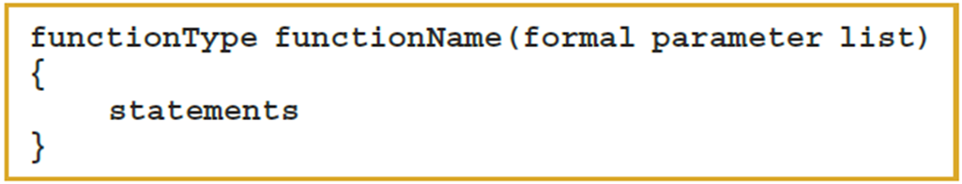
Syntax: Value-Returning Function
Syntax
functionType is also called the data type or return type

Slide 12
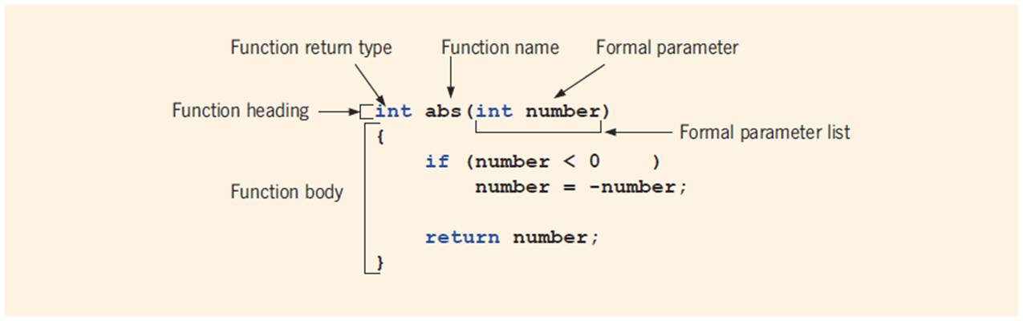
Syntax: Formal Parameter List
FIGURE 6-1 Various parts of the function abs

Slide 13

Function Call
Syntax to call a value-returning function

Slide 14


Syntax: Actual Parameter List
The syntax of the actual parameter list is:
The formal parameter list can be empty
A call to a value-returning function with an empty formal parameter list is:

Slide 15
return Statement
A function returns its value via the return statement
It passes this value outside the function

Slide 16

Syntax: return Statement (1 of 2)
The return statement has this syntax:
In C++, return is a reserved word
When a return statement executes
The function immediately terminates
Control goes back to the caller
When a return statement executes in the function main, the program terminates

Slide 17
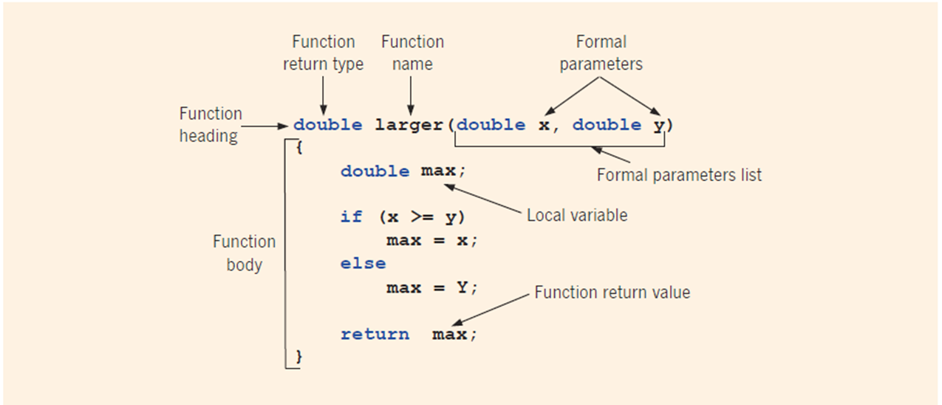
Syntax: return Statement (2 of 2)
FIGURE 6-2 Various parts of the function larger

Slide 18
Function Prototype
A function prototype is the function heading without the body of the function
The general syntax of the function prototype of a value-returning function is:
It is not necessary to specify the variable name in the parameter list
The data type of each parameter must be specified

Slide 19
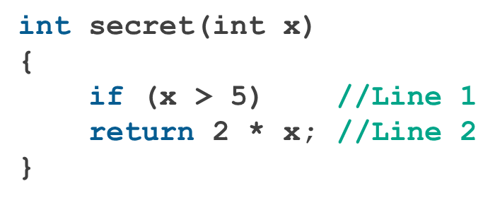
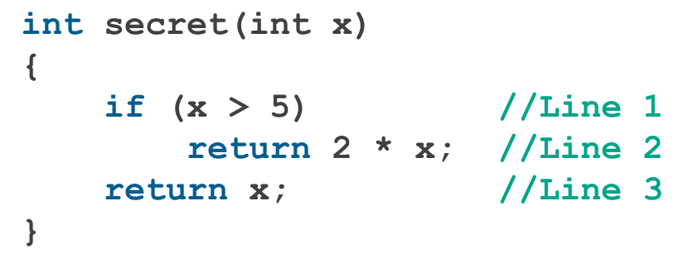
Value-Returning Functions: Some Peculiarities (1 of 2)
A correct definition of the function secret is:

Slide 20
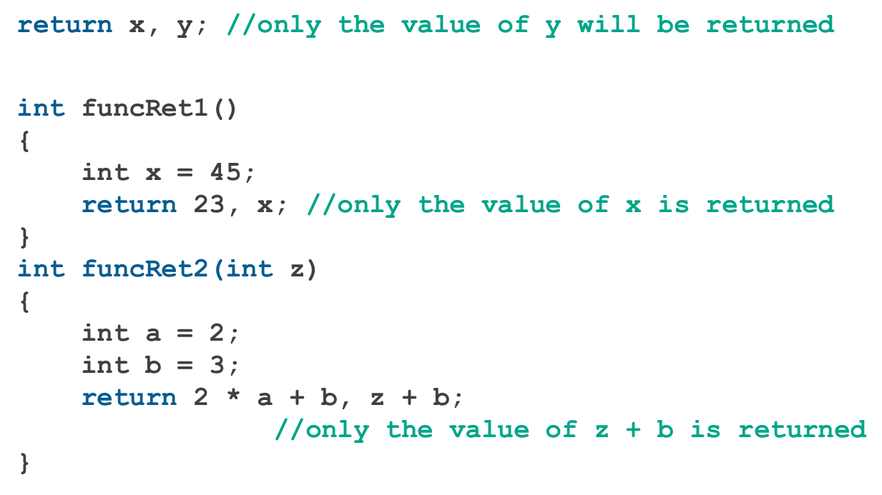
Value-Returning Functions: Some Peculiarities (2 of 2)
Examples pointing out that the return statement only returns one value

Slide 21
Problem: Even or Odd Number Check
In this exercise, you are required to write a program that checks whether a given number is even or odd. The program will prompt the user for a number and display a message indicating whether the number is even or odd.
Instructions:
Function Declaration:
Write a function bool isEven(int num) that takes an integer num as input and returns true if the number is even, and false if it is odd.
Main Function:
Inside the main function, prompt the user to enter a number.
Use the isEven function to check if the number is even or odd.
Based on the return value of the isEven function, display whether the number is "even" or "odd".

Slide 22
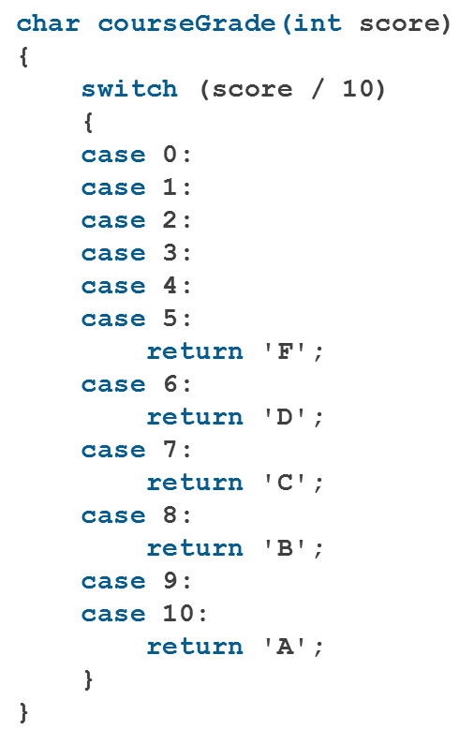
More Examples of Value-Returning Functions (1 of 2)

Slide 23
More Examples of Value-Returning Functions (2 of 2)
In addition to Example 6-3 courseGrade, other examples are given in the text
Example 6-4 (rolling a pair of dice)
Example 6-5 (Fibonacci number)
Example 6-6 (palindrome)
Example 6-7 (cable company)

Slide 24
Flow of Compilation and Execution (1 of 2)
Execution always begins at the first statement in the function main
Other functions are executed only when called
Function prototypes appear before any function definition
The compiler translates these first
The compiler can then correctly translate a function call

Slide 25
Flow of Compilation and Execution (2 of 2)
A function call transfers control to the first statement in the body of the called function
When the end of a called function is executed, control is passed back to the point immediately following the function call
A function’s returned value replaces the function call statement

Slide 26
Void Functions (1 of 4)
User-defined void functions can be placed either before or after the function main
If user-defined void functions are placed after the function main
The function prototype must be placed before the function main
A void function does not have a return type
A return statement without any value is typically used to exit the function early

Slide 27
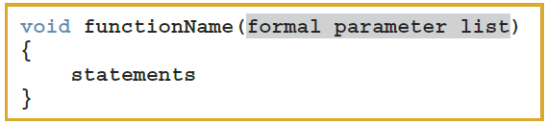
Void Functions (2 of 4)
Formal parameters are optional
A call to a void function is a stand-alone statement
The function definition of void functions with parameters has the following syntax:

Slide 28

Void Functions (3 of 4)
Formal parameter list syntax
Function call syntax
Actual parameter list syntax

Slide 29
Void Functions (4 of 4)
Two types of formal parameters
Value parameter: a formal parameter that receives a copy of the content of corresponding actual parameter
Reference parameter: a formal parameter that receives the location (memory address) of the corresponding actual parameter

Slide 30
Value Parameters
If a formal parameter is a value parameter, the value of the corresponding actual parameter is copied into it
A formal parameter has its own copy of the data
During program execution, a formal parameter manipulates the data stored in its own memory space

Slide 31
Reference Variables as Parameters (1 of 2)
If a formal parameter is a reference parameter:
It receives the memory address of the corresponding actual parameter
During program execution to manipulate data:
Changes to a formal parameter will change the corresponding actual parameter

Slide 32
Reference Variables as Parameters (2 of 2)
Reference parameters are useful in three situations:
When changing the actual parameter
When returning more than one value
When passing the address would save memory space and time

Slide 33
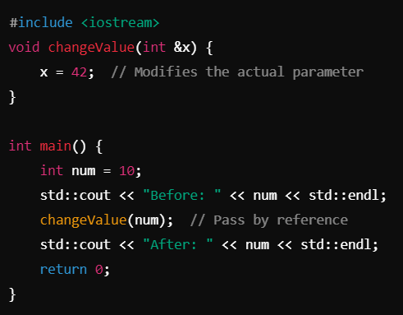

Slide 34
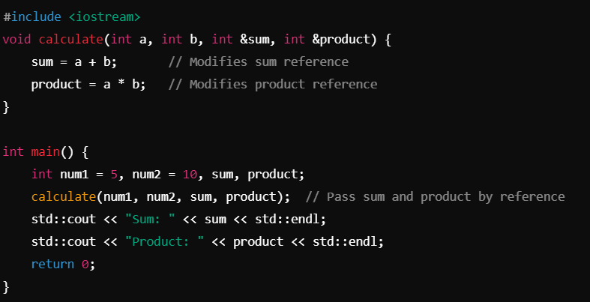

Slide 35
Value and Reference Parameters and Memory Allocation (1 of 2)
When a function is called:
Memory for its formal parameters and its local variables is allocated in the function data area
For a value parameter, the actual parameter’s value is copied into the formal parameter’s memory cell
Changes to the formal parameter do not affect the actual parameter’s value

Slide 36
Value and Reference Parameters and Memory Allocation (2 of 2)
For a reference parameter, the actual parameter’s address passes to the formal parameter
Both formal and actual parameters refer to the same memory location
During execution, any change made to the formal parameter’s value immediately changes the actual parameter’s value

Slide 37
Reference Parameters and Value-Returning Functions
Can also use reference parameters in a value-returning function
Not recommended
By definition, a value-returning function returns a single value via return statement
If a function needs to return more than one value, change it to a void function and use reference parameters to return the values

Slide 38
Scope of an Identifier
Scope of an identifier: where in the program the identifier is accessible
Local identifier: identifiers declared within a function (or block)
Global identifier: identifiers declared outside of every function definition
C++ does not allow nested functions
Definition of one function cannot be included in the body of another function

Slide 39
Rules Applied When an Identifier is Accessed (1 of 2)
Global identifiers are accessible by a function or block if:
The identifier is declared before the function definition (block)
The function name different from the identifier
All parameters to the function have different names than the identifier name
All local identifiers have different names than the identifier name

Slide 40
Rules Applied When an Identifier is Accessed (2 of 2)
(Nested block) – an identifier declared within a block is accessible:
From its point of declaration to the end of the block in which it is declared
Within nested blocks if no identifier with the same name exists
The scope of a function name is similar to the scope of an identifier declared outside any block
The function name scope is the same as the global variable scope

Slide 41
Other Notes about Global Variables
Some compilers initialize global variables to default values
The scope resolution operator in C++ is ::
By using the scope resolution operator:
A global variable declared before the definition of a function (or block) can be accessed by the function (or block) even if the function (or block) has an identifier with the same name as the global variable
To access a global variable declared after the definition of a function, the function must not contain any identifier with the same name
Reserved word extern indicates that a global variable has been declared elsewhere

Slide 42
Global Variables, Named Constants, and Side Effects
Using global variables causes side effects
A function that uses global variables is not independent
If more than one function uses the same global variable:
It can be difficult to debug problems with the code
Problems caused in one area of the program may appear to be from another area
Global named constants have no side effects

Slide 43
Static and Automatic Variables (1 of 2)
Automatic variable: memory is allocated at block entry and deallocated at block exit
By default, variables declared within a block are automatic variables
Static variable: memory remains allocated as long as the program executes
Global variables declared outside of any block are static variables

Slide 44

Static and Automatic Variables (2 of 2)
Declare a static variable within a block by using the reserved word static
The syntax for declaring a static variable is:
Static variables declared within a block are local to the block
Have same scope as any other local identifier in that block

Slide 45
Debugging: Using Drivers and Stubs
A driver program is a separate program used to test a function
When results calculated by one function are needed in another function, use a function stub
A function stub is a function that is not fully coded

Slide 46
Function Overloading: An Introduction
In a C++ program, several functions can have the same name
Function overloading (or overloading a function name) occurs when creating several functions with the same name
Two functions are said to have different formal parameter lists if both functions have either:
A different number of formal parameters
If the number of formal parameters is the same, but the data type of the formal parameters differs in at least one position

Slide 47
Function Overloading
Overloaded functions must have different formal parameter lists
The signature: the name and formal parameter list of the function
Does not include the return type of the function
The parameter list supplied in a call to an overloaded function determines which function is executed

Slide 48
Functions with Default Parameters (1 of 2)
In a function call, the number of actual and formal parameters must be the same
C++ relaxes this condition for functions with default parameters
Can specify the value of a default parameter in the function prototype
If you do not specify the value for a default parameter when calling the function, the default value is used

Slide 49
Functions with Default Parameters (2 of 2)
All default parameters must be the rightmost parameters of the function
If a default parameter value is not specified:
You must omit all of the arguments to its right
Default values can be constants, global variables, or function calls
Cannot assign a constant value as a default value to a reference parameter

Slide 50
Quick Review (1 of 4)
Functions (modules) divide a program into manageable tasks
C++ provides standard, predefined functions
Two types of user-defined functions: value-returning functions and void functions
Variables defined in a function heading are called formal parameters
Expressions, variables, or constant values in a function call are called actual parameters

Slide 51
Quick Review (2 of 4)
Function heading and the body of the function are called the definition of the function
A value-returning function returns its value via the return statement
A prototype is the function heading without the body of the function
User-defined functions execute only when they are called
Void functions do not have a data type

Slide 52
Quick Review (3 of 4)
There are two types of formal parameters
A value parameter receives a copy of its corresponding actual parameter
A reference parameter receives the memory address of its corresponding actual parameter
Variables declared within a function (or block) are called local variables
Variables declared outside of every function definition (and block) are global variables

Slide 53
Quick Review (4 of 4)
An automatic variable is a variable for which memory is allocated on function/block entry and deallocated on function/block exit
A static variable is a variable for which memory remains allocated throughout the execution of the program
C++ functions can have default parameters

